Slide 1


Look At The Barrage
From Another Angle
—— Visualization of Barrage Data
With Python & Text Sentiment Analysis
2030223131 Zhao LUO (罗钊)
2030223118 Sunqingnian WANG (王孙卿念)
2030223158 Shuang PENG (彭爽)

Slide 2

01
Data Crawling and Data Cleaning
CONTENTS
Page 4 to Page 9
02
Basic Visual Analysis of Barrage Data
Page 10 to Page 13
03
Data Word Cloud Display
Page 14 to Page 23
04
Text Sentiment Analysis & Resampling
Page 24 to Page 31
05
Summary and Outlook
Page 32

Slide 3
INTRODUCTION
The exciting offer season 2 program mainly tells the story of eight law school students who embrace the lawyer's dream and experience a one-month internship in law firms under the teaching and assessment of four lawyers, and compete for the positive offer of two law firms.
Analyze these screen data. Then analyze some of the user's situation, as well as the user's attitude to the program.

Slide 4
01
«
Data Crawler, Data Cleaning

Slide 5
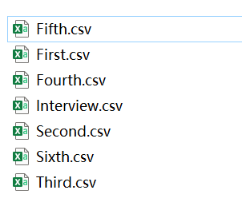
PART ONE
Zhao LUO (罗钊)
DATA CRAWLER
Total data collected by reptiles
A total of 261,724 pieces of data
Seven csv documents were generated.

Slide 6
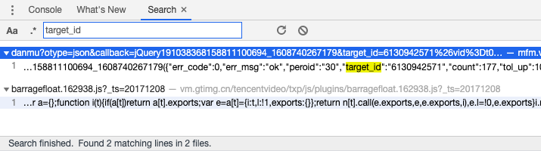
PART ONE
Zhao LUO (罗钊)
USE target_id & vid Get Video Barrage
A fixed url address + video cid + .xml
Find the video cid, replace the url to crawl all the barrage
Right-click the webpage, open the source code of the webpage, search for "cid": you can find them

Slide 7
PART ONE
Zhao LUO (罗钊)
Remove Special Characters
Data Consolidation
Send Time Processing
Rename Field
Remove Duplicates
Missing Value Processing
Mechanical Compression to Remove Weight
Export Cleaning File

Slide 8
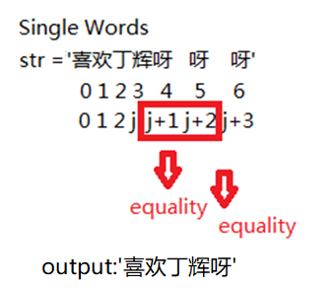
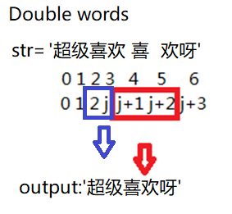
Mechanical Compression Deweighting Function
PART ONE
Zhao LUO (罗钊)
The data in the sentence
removes repetition.
Compared to above, three-words has the same principle.

Slide 9
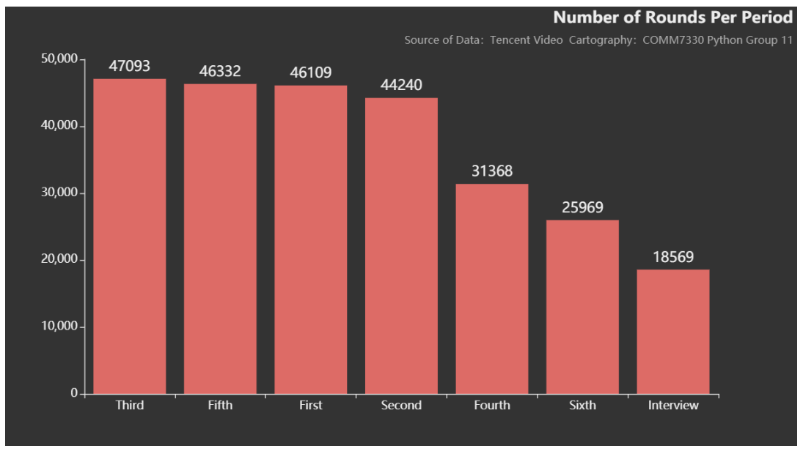
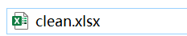
PART ONE
Zhao LUO (罗钊)
Generate clean.xlsx document after cleaning
A total of 259,691 pieces of data
Histogram of Data Distribution After Cleaning

Slide 10
02
«
Basic Visual Analysis of Barrage Data

Slide 11

PART TWO
Zhao LUO (罗钊)
Total Word Cloud
Ding Hui's super popularity
The audience's love for this variety

Slide 12
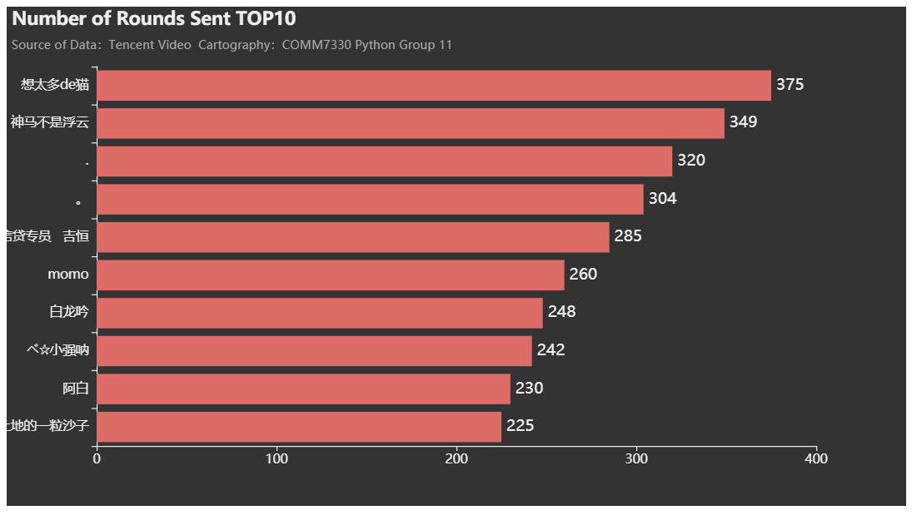
WHO IS
THE BARRAGE TRANSMITTER?
Zhao LUO (罗钊)
PART TWO
TOP 10
ID of the users with the most screens is "想太多de猫".

Slide 13
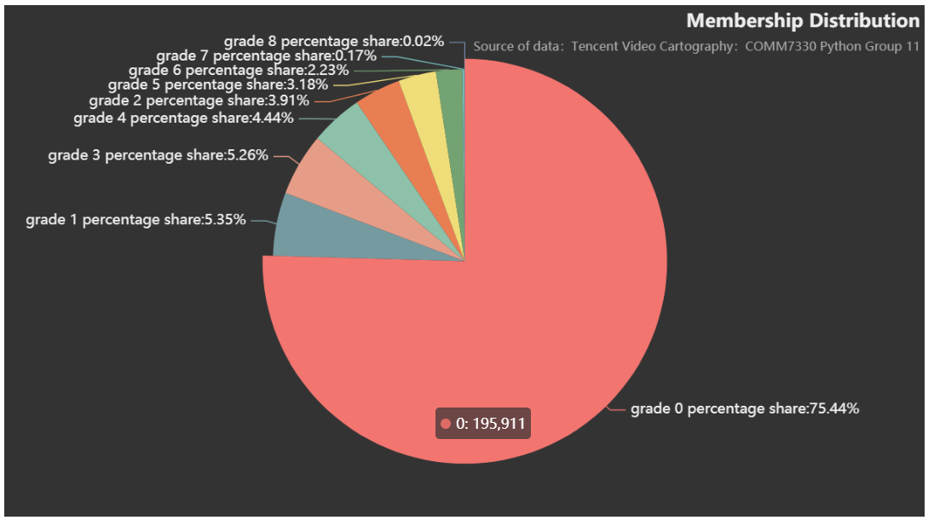
PART TWO
Zhao LUO (罗钊)
Member Level Distribution Pie Chart
User stickiness is strong

Slide 14
03
«
Data Word Cloud Display

Slide 15
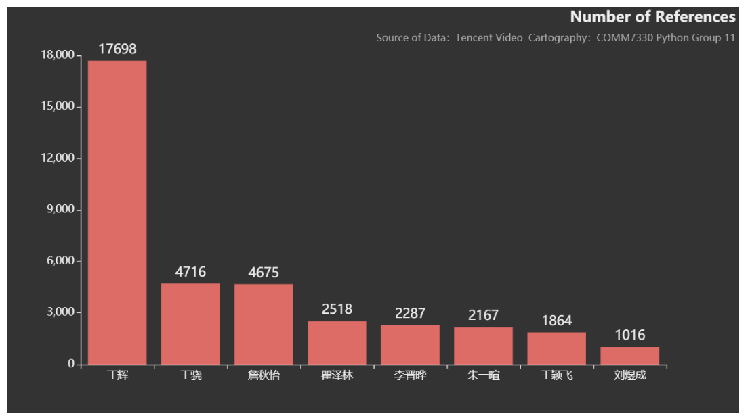
PART TWO
PART THREE
Shuang PENG (彭爽)
Number of intern role mentions
Ding Hui
Wang Xiao
Liu Yucheng

Slide 16

PART THREE
Shuang PENG (彭爽)
Come on
Like
Look Good
Support
这张图调整成为了透明的，讨论一下效果，看看是用什么比较合适。
Barrage Word Cloud of Hui DING

Slide 17

PART THREE
Shuang PENG (彭爽)
这张图调整成为了透明的，讨论一下效果，看看是用什么比较合适。
Beautiful
Liu Yifei
Good-Looking
Barrage Word Cloud of Qiuyi ZHAN

Slide 18

PART THREE
Shuang PENG (彭爽)
The Top University Stanford
A Two-Sided Situation
Good
Versailles
Barrage Word Cloud of Xiao WANG

Slide 19

PART THREE
Shuang PENG (彭爽)
Cute
Hate
Barrage Word Cloud of Yixuan ZHU

Slide 20

PART THREE
Shuang PENG (彭爽)
High Emotional Intelligence
Cute
Barrage Word Cloud of Zelin QV

Slide 21

PART THREE
Shuang PENG (彭爽)
Handsome
He Yunchen
Barrage Word Cloud of Jinye LI

Slide 22

PART THREE
Shuang PENG (彭爽)
这张图调整成为了透明的，讨论一下效果，看看是用什么比较合适。
Good-Looking
Beautiful
Barrage Word Cloud of Yingfei WANG

Slide 23

PART THREE
Shuang PENG (彭爽)
这张图调整成为了透明的，讨论一下效果，看看是用什么比较合适。
A High Score in The Examination Good Professional Knowledge
Distress
Barrage Word Cloud of Yucheng LIU

Slide 24
04
«
Text Sentiment Analysis & Resampling

Slide 25
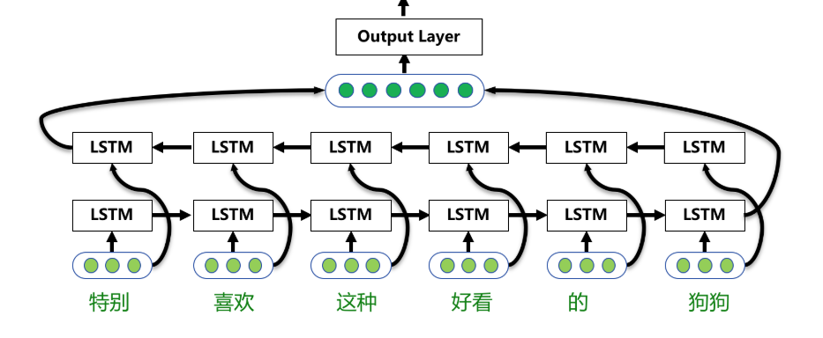
PART FOUR
Sunqingnian WANG (王孙卿念)
Baidu Senta model, bi-LSTM (bidirectional long short term memory)
Text Sentiment Analysis Model

Slide 26


PART FOUR
Sunqingnian WANG (王孙卿念)
JUDGMENT STANDRAD
>0.5
=0.5
<0.5
POSITIVE
NEUTRAL
NEGATIVE

Slide 27
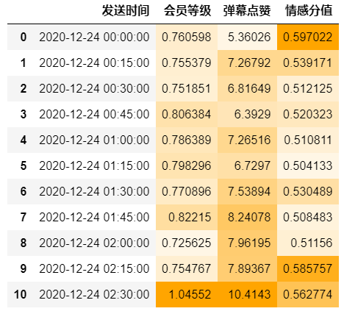
PART FOUR
Sunqingnian WANG (王孙卿念)
Transmitting
Time
Membership
Grade
Barrage
Click
Emotional
Score
Emotional Visualization
The emotional score is stable above 0.5, and the program is positive and controversial.

Slide 28
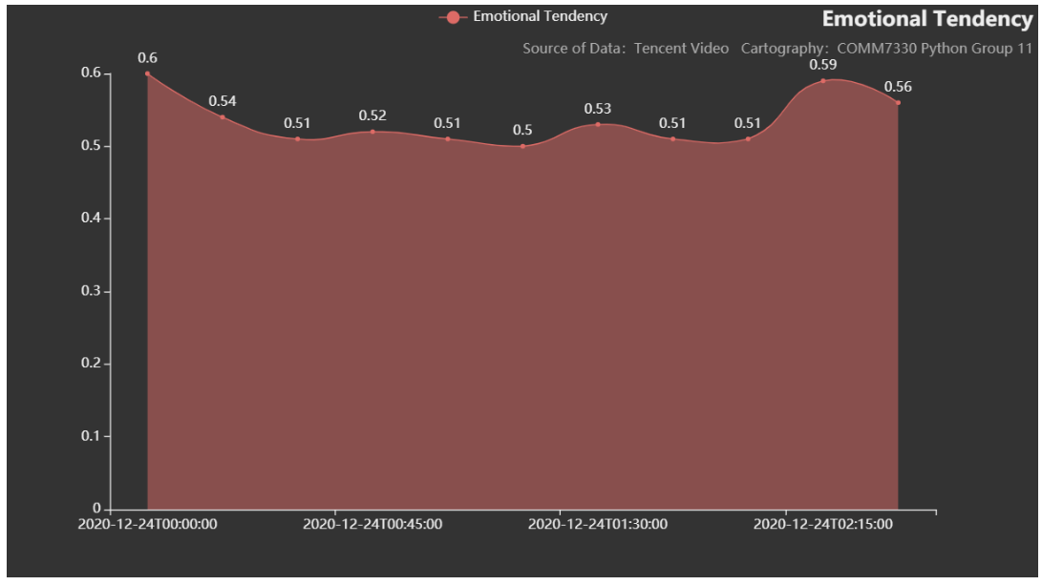
PART FOUR
Sunqingnian WANG (王孙卿念)
Relationship Between Sending Time and Emotional Score
Scenes with a high degree of discussion appear regularly, keeping the audience's continuous watching enthusiasm.

Slide 29
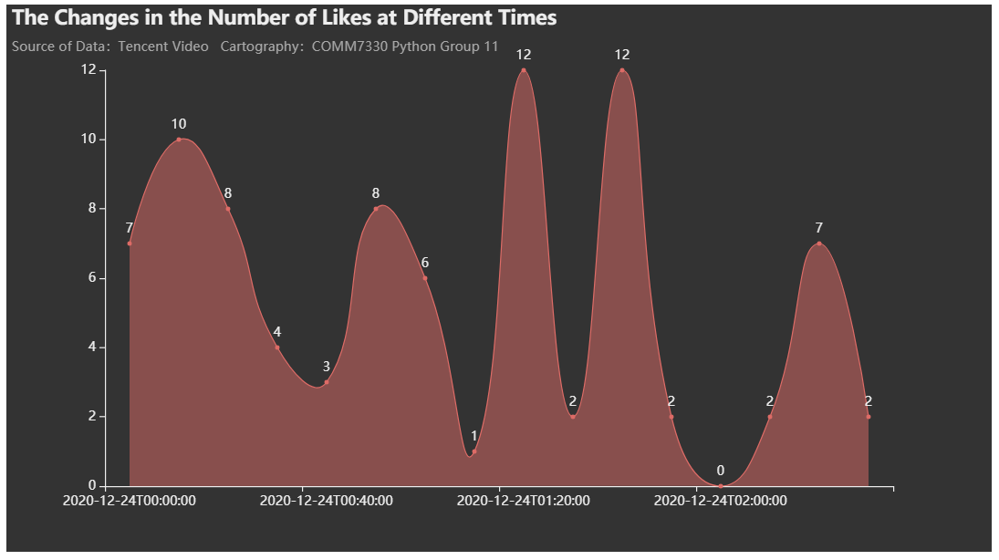
PART FOUR
Sunqingnian WANG (王孙卿念)
Changes in Likes at Different Sending Times
There needs to be words or scenes that stimulate the audience's cognition.

Slide 30
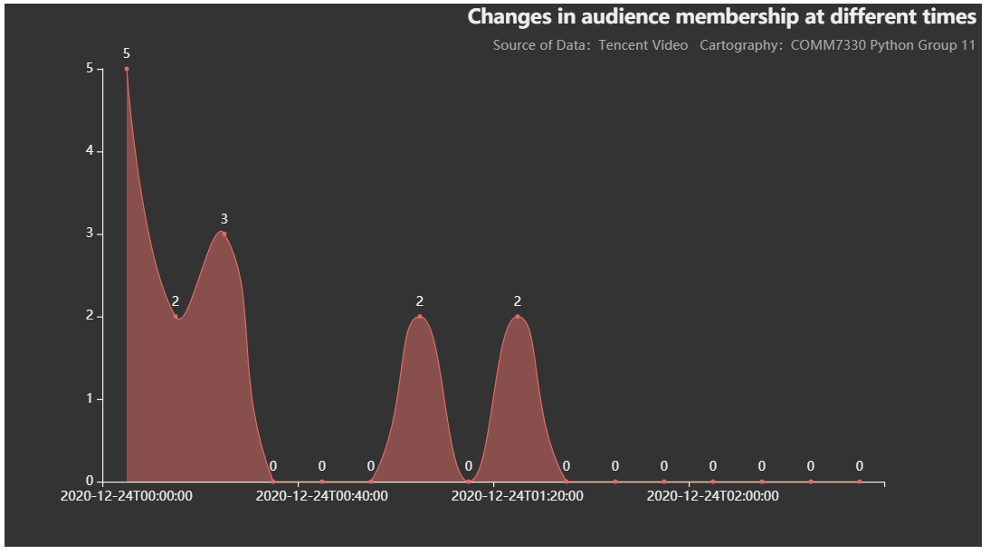
PART FOUR
Sunqingnian WANG (王孙卿念)
Membership Level Changes at Different Times
Non-members account for a large proportion, and viewers watch programs not because of "member stickiness".

Slide 31
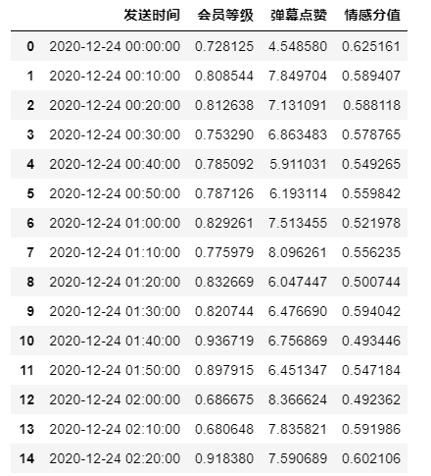
PART FOUR
Sunqingnian WANG (王孙卿念)
Transmitting
Time
Membership Grade
Barrage
Click
Emotional
Score
Resampling
After resampling, generate and save the document with added emotional score column to Re-sampling.xlsx

Slide 32
05
«
Summary and Outlook
1. The Future Development of Senta
2. Further Improvement of The Project
In the future work and life, when we are engaged in some work related to program evaluation or content hotspot extraction, we can apply the technology involved in this project to practice, speak based on data, and more accurately judge market demand and conduct commercialization analysis to maximize benefits in all aspects.

Slide 33

THANK
YOU

